Slide 1
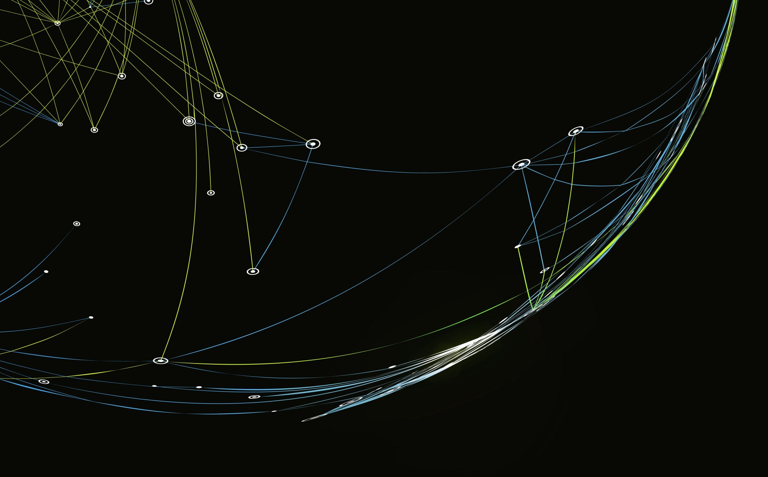
DevOps Fundamental Project
QA Trainee Brendan Kirkby

Slide 2
Brief
The DevOps Fundamental project is designed to fully test and showcase my knowledge from the first half of the DevOps course. As such this project is to:
Create a CRUD application with utilisation of supporting tools, methodologies and technologies that encapsulate all core modules covered during training.
MVP Of the project:
A fully complete web application built in python using the micro web-framework Flask that allows for the utilisation of Create, Read, Update and Delete functionality.

Slide 3
Requirements for MVP
A Kanban board tech element with full expansion on user stories, use cases and tasks needed to complete the project. (A)
A relational database used to store data persistently for the project, with at least 2 tables within it, consisting of two or more one->many relationships. (B)
Clear documentation from a design phase describing the architecture used for the project, as well as a detailed Risk Assessment. (C)
A functional CRUD application, created in Python, following best practices and design principles, that meets the requirements set on the Kanban board. (D)
Fully designed test suites for the application, as well as automated tests for validation of the application. High test coverage must be achieved for the back-end with consistent reports and evidence to support a TDD approach. (E)
A functioning front-end website and integrated API’s using Flask. (F)
Code fully integrated into a Version Control System using the Feature-Branch model which will subsequently be built though a CI server and deployed to a cloud-based virtual machine. (G)

Slide 4
Platform Specific Requirements
Kanban Board (Trello or other equivalent)
Database: GCP SQL Server or other Cloud Hosted managed Database
Programming language: Python
Unit Testing with Python: Pytest
Integration Testing with Python (Selenium)
Front-end: Flask micro-framework (HTML)
Version Control: Git
CI Server: Jenkins
Cloud server: GCP Compute Engine

Slide 5
Idea- Fishing Locations/Spots
A web app where users can log the various fish they have caught and feel are worthy of sharing, along with the relevant information, such as location (co-ordinates), how long it took them to get the fish.
This app would satiate the MVP CRUD Functionality by allowing:
Create:
User profiles - (Username, ID (Auto Generated on submission of form) Forename, Surname, Email, Region, Gear List (Optional),Top Catch (Fish Name, Fish Species (Optional), Fish Length, Fish Weight, Location of the fish).
“Catch Diary” – Log of each fish caught, containing (Fish Name, Weight, Length, Time to catch, Date, Location, Weather(Optional), Image (Optional), User who caught, Description of encounter(Updatable).
Read: Users are able to view the catch diary and search for any catches that are assigned to their ID, shown on their profile once it is created.
Update: Users are able to update their own user profile, as well as the description of any catch they have made.
Delete: Users are able to delete their user profile, though the Catch Diary may remain unchanged.

